Slide 1

Meteorite Landings Analysis
This analysis aims to uncover patterns and trends, in this case a specific focus on identifying geographic distribution of large meteorites.
The primary objective is to understand the geographical distribution of the largest meteorites. By pinpointing regions with a higher frequency of large meteorite landings, we can make observations on where these large meteorites land and why this observation is important.
The process:
1. Connected Tableau to the dataset containing meteorite landing data.
2. Initially, I used the latitude and longitude fields to create a map pinpointing all meteorite landing locations worldwide.
3. I created a calculated field to classify meteorites based on mass, filtering out those under 1 million grams. After filtering, I updated the map to show only "heavy" meteorites.
4. I grouped the remaining meteorites by the region they were in. I then color-coded the meteorite pins on the map based on the region they belong to.
5. Adjusted the size of the pins on the map to reflect the weight of the meteorites. Larger pins represent heavier meteorites.
6. Created a separate bar graph visualizing the total grams of "heavy" meteorites in different regions.

Slide 2
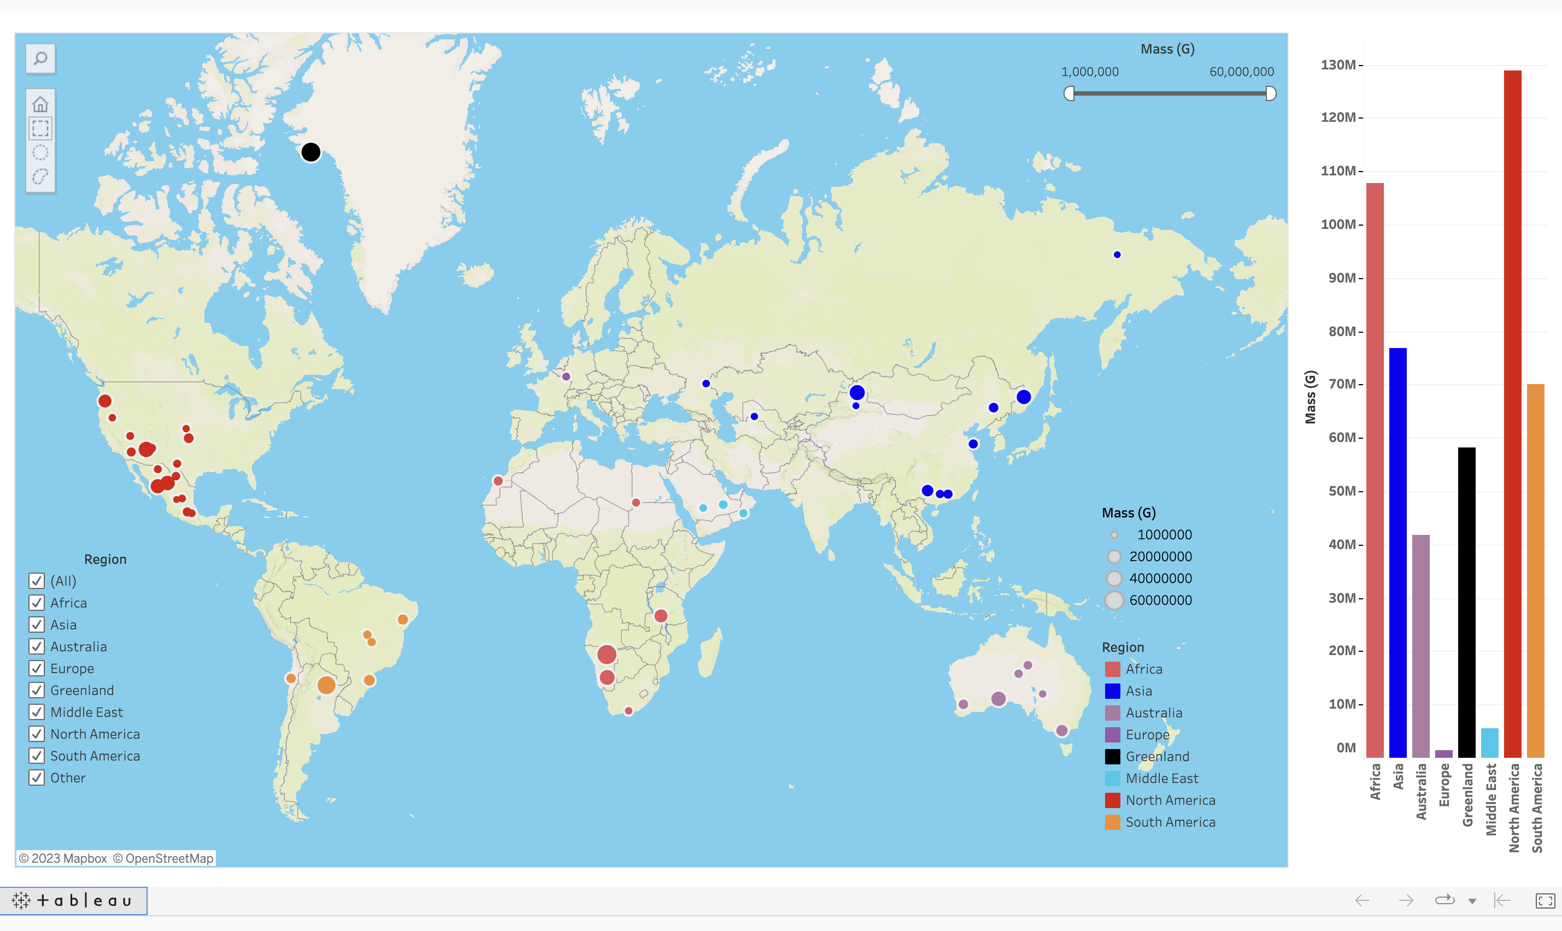
Geographic and Mass Analysis: Visualizations

Slide 3
Discoveries, Connections, and Implications
Key Findings:
North American Dominance:
- North America stands out with the highest number of “heavy” meteorites (19) and the highest total grams (128 million).
Africa’s Remarkable Impact:
- Africa, with only 6 meteorites, ranks second in total grams (60 million grams) and boasts the heaviest individual meteorite (60 million grams).
Greenland's Noteworthy Contribution:
- Greenland, though having only one meteorite, recorded the second-largest individual meteorite, weighing a substantial 58 million grams.
Connections and Observations:
- A significant number of North America's meteorites are concentrated along the west.
- Regions with more meteorites do not necessarily have the heavier overall mass.
- Africa and Greenland, with fewer meteorites, showcase concentrated impacts with notably heavy meteorites.
Predicting Future Meteorite Landings:
By understanding the most common areas for heavy meteorite landings, we can develop predictive models for potential future events.
Benefits of Predictions:
- Early Warning Systems: Early identification of regions at higher risk allows for the development of early warning systems.
- Infrastructure Protection: Governments and communities can reinforce infrastructure in areas identified as high-risk zones, minimizing potential damage.

